Slide 1


SafeKit Overview
High availability software for critical applications
Notes:
These slides are timed and automatically move from one to the next after a delay. To remove this automation: Go to 'Slide Show' and uncheck 'Use Timings’.
The slides have a soundtrack represented by an audio icon on the right side of each slide. To remove the soundtrack, click on each audio icon and lower the volume to the minimum.
Welcome, and thank you for joining us today.
It is a pleasure to have you here as we delve into the distinctive advantages of SafeKit, a solution that stands out in the realm of high availability and disaster recovery.
You will discover that SafeKit is a high availability software solution, designed to ensure 24/7 uptime for business-critical applications.
It supports both Windows and Linux platforms and eliminates the need for shared disks, enterprise editions of databases, or advanced technical skills, making it a cost-effective alternative to traditional clustering solutions.

Slide 2
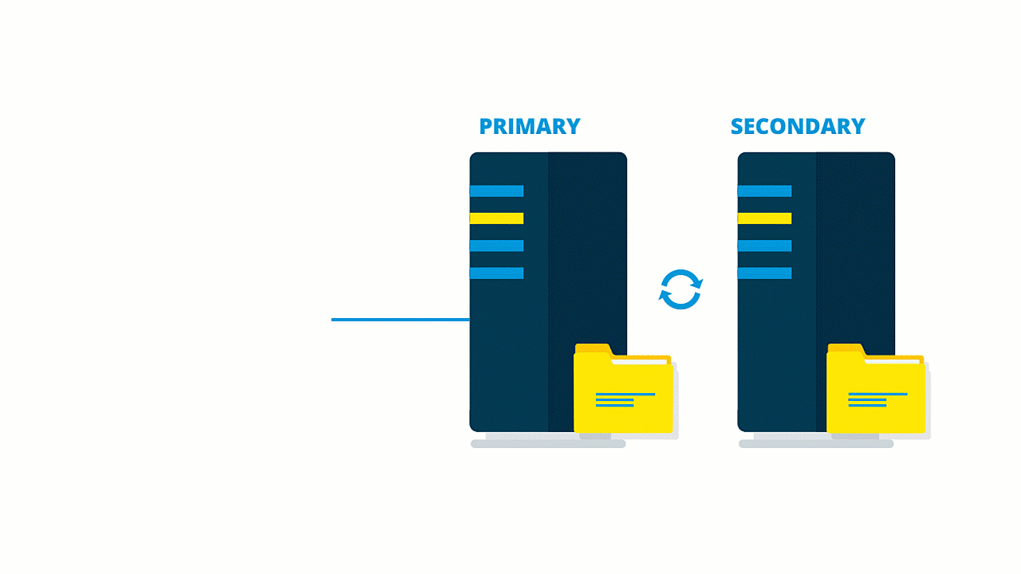

Demonstration of SafeKit
High Availability of Critical Applications
Notes:
Let me present to you the benefits of using SafeKit for a critical application in the industry, specifically a SCADA or Supervisory Control and Data Acquisition application. Imagine a user running a GUI, connected to two servers running the application, with SafeKit ensuring real-time replication of the application data and automatic failover.
First and foremost, SafeKit guarantees high availability and redundancy.
This means that the application will remain operational 24/7. In the event of a server failure, SafeKit automatically switches the application to the secondary server without any data loss.
This is crucial for critical applications like SCADA, where continuous monitoring and control are essential.
SafeKit provides real-time synchronous replication, ensuring that any changes made to the application data on the primary server are immediately replicated to the secondary server. This guarantees that both servers have identical data at all times, preventing data loss in case of a server failure.
In the event of a failure of the primary server, SafeKit automatically switches the application to the secondary server. This failover process is seamless and does not require manual intervention, ensuring that the SCADA application is restarted automatically.
One of the key advantages of SafeKit is its simplified management.
It does not require specialized IT skills for deployment and management.
The solution is platform-agnostic and works with standard editions of Windows and Linux, eliminating the need for specific hardware like shared disks.

Slide 3


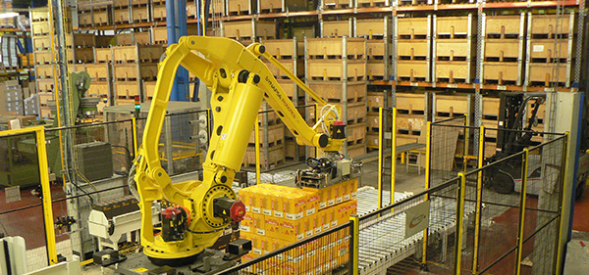



Examples of redundancy and high availability solutions
SafeKit use cases
Vehicle inspection – Gatekeeper
Video surveillance – Axians
Automated logistics - Fives
Air traffic control – ADB SafeGate
Grand Paris Express - Siemens
Physical access control – Nedap, TIL
Notes:
Let me share some real-world examples of how SafeKit ensures high availability and redundancy for critical applications across various industries. These use cases have been implemented by our partners with their critical applications at many customers.
In vehicle inspection, SafeKit is utilized by Gatekeeper to keep their inspection systems operational at all times. The real-time replication and automatic failover capabilities ensure that any server failure does not disrupt the inspection process.
In video surveillance, Axians relies on SafeKit for continuous monitoring and recording of surveillance footage. SafeKit's high availability features prevent downtime, ensuring that surveillance systems remain fully functional.
In automated logistics, Fives uses SafeKit to maintain the high availability of their logistics automation systems. This ensures that logistics processes are not interrupted, enhancing efficiency and productivity.
For air traffic control, ADB SafeGate employs SafeKit to ensure the reliability and availability of their air traffic management systems. SafeKit's high availability features prevent disruptions that could impact flight safety and scheduling.
In the Grand Paris Express project, Siemens uses SafeKit to ensure the high availability of their control systems for the new metro lines. SafeKit's real-time replication and automatic failover capabilities provide the necessary redundancy to keep these systems running smoothly.
Lastly, in physical access control, companies like Nedap and TIL rely on SafeKit to maintain the availability of their access control systems. SafeKit's high availability features ensure continuous protection and security.
These examples illustrate the versatility and robustness of SafeKit in providing high availability and redundancy solutions across various industries.

Slide 4
SafeKit / Milestone
Milestone
Video surveillance
Leader in VMS
SafeKit
30+ countries
Redundancy of Milestone
Notes:
I'd like to present the global reach and impact of SafeKit, particularly in collaboration with Milestone, a leader in video surveillance and video management systems (VMS).
Milestone's video management systems are widely recognized for their reliability and advanced features.
However, to ensure continuous operation and prevent any downtime, redundancy is crucial.
This is where SafeKit comes into play.
SafeKit, in collaboration with Milestone, has been implemented in over 30 countries, providing robust redundancy and high availability solutions for video surveillance systems.
This demonstrates that with SafeKit, partners can confidently deploy high availability solutions for their customers, ensuring seamless and uninterrupted service.

Slide 5
Choose between 2 solutions with SafeKit
Virtual machine cluster
Application cluster
SafeKit installed at the hypervisor level (Hyper-V, KVM)
No integration: works with any application
Replicates and restarts a full virtual machine
Time to reboot the VM on server 2 if crash of server 1
Does not work with VMware (except by nesting Hyper-V or KVM inside VMware)
VM checker to test that the VM is running
SafeKit installed where the application runs (modules)
Integration: define services to restart, folders to replicate, virtual IP
Replicates and restarts only the application
Quick restart of App on server 2 if crash of server 1
Works in any configuration (any servers, any hypervisors, cloud)
Application checker to test that the application is running
App
App
App
App
OS
OS
OS1
OS2
VM
VM files replica
App files replica
Notes:
Let's explore the high availability solutions provided by SafeKit at both the virtual machine level and the application level.
First, let's explore virtual machine level high availability. SafeKit operates at the hypervisor level, such as Hyper-V or KVM, to provide high availability for entire virtual machines.
This setup is particularly advantageous because it does not require any specific integration with the applications running within the virtual machines.
SafeKit replicates and restarts the entire virtual machine, including the operating system and the application, in the event of a failure.
This ensures that the virtual machine is rebooted on the secondary server, maintaining continuous operation.
The virtual machine cluster is a solution that works with any application, making it an ideal choice when you don't know how the application works. However, this solution is limited to Hyper-V and KVM infrastructures and is not available on VMware, unlike the application cluster solution. Several virtual machines can run on the two physical servers with crossed replication, automatic failover and migration features.
Now, let's delve into application level high availability.
In this configuration, SafeKit is installed directly where the application runs, and specific modules are defined for each application.
This setup requires some integration, such as defining the services to restart in case of failure, the folders to replicate, and a virtual IP address.
The application cluster replicates and restarts only the application, not the entire virtual machine.
This allows for a quicker restart of the application on the secondary server if the primary server fails.
The application cluster is highly flexible and can be deployed in various configurations, including physical servers, virtual servers, any hypervisors, and cloud environments.
This solution is particularly beneficial for applications that require minimal downtime and quick recovery in any type of infrastructure.
In conclusion, VM-level high availability does not require any knowledge of the application but is limited to Hyper-V and KVM infrastructures. On the other hand, application-level high availability offers an infrastructure-independent solution but requires defining services to restart and folders to replicate.

Slide 6
Distinctive advantages
Solutions | Complexity | Comments
Failover Cluster (Microsoft) | High | Specific Storage (shared storage, SAN)
Virtualization (VMware HA) | High | Specific Storage (shared storage, SAN, vSAN)
SQL Always-On (Microsoft) | High | Only SQL is redundant SQL Enterprise Edition
SafeKit | Low | Simplest, generic and software-only Unsuitable for large data replication
Notes:
As we navigate through the complexities of various solutions, it becomes evident that SafeKit offers unique benefits that cater to a wide range of needs.
Let's begin by examining some of the common solutions in the market.
The complexity of Microsoft Failover Cluster arises from the specific shared storage requirements between nodes, which must be connected via a storage area network (SAN).
Similarly, VMware HA is a prime example of a virtualization solution that also demands specific shared storage configurations on a SAN or vSAN.
SQL Always-On, provided by Microsoft, removed the need for shared storage but it focuses primarily on SQL redundancy and cannot replicate other data.
It requires SQL Enterprise Edition, which can be costly and limits redundancy to SQL databases only.
The complexity of setting up and maintaining such environments can be daunting for many partners who simply want to add a high availability option to their application.
Now, let's turn our attention to SafeKit.
SafeKit is a low-complexity solution that is both simple and generic.
Unlike the other solutions mentioned, SafeKit is software-only and does not require any shared storage configurations.
This makes it incredibly easy to deploy and manage. Despite its simplicity, SafeKit does not compromise on effectiveness; it provides robust high availability and disaster recovery capabilities. However, it is important to note that SafeKit may not be suitable for large-scale data replication. Nevertheless, its advantages in terms of simplicity, cost-effectiveness, and ease of deployment make it an attractive option for many organizations.

Slide 7
Thank you !
Notes:
As we conclude our discussion on SafeKit, I would like to extend my heartfelt thanks to each one of you.
Your time and attention have been greatly appreciated, and it has been a privilege to share the distinctive advantages of SafeKit with you.
I look forward to future opportunities to connect and share more with you.

