Slide 1


SafeKit Troubleshooting
Notes:
These slides are timed and automatically move from one to the next after a delay. To remove this automation: Go to 'Slide Show' and uncheck 'Use Timings’.
The slides have a soundtrack represented by an audio icon on the right side of each slide. To remove the soundtrack, click on each audio icon and lower the volume to the minimum.
I am going to present how to troubleshoot SafeKit by analyzing logs and their messages, so you can resolve issues on your own. This process will help you identify the root causes of common issues and provide step-by-step solutions.

Slide 2
SafeKit Troubleshooting
01
Analyze yourself the logs
05
Command line issues
02
Running an application without SafeKit
06
Mirror Module issues
03
Take module snapshots for support
07
Farm module issues
04
Web console issues
08
Checker issues
Notes:
Here is an outline of the different topics covered for SafeKit troubleshooting:
In 1, we encourage you to analyze the logs yourself to identify and resolve potential issues.
In 2, we explain how to run an application without SafeKit.
In 3, we describe how to take module snapshots at a customer site and how to diagnose and resolve issues quickly from snapshots.
In 4, we cover issues that can happen with the web console.
In 5, we do the same with command lines.
In 6, we address how to solve mirror module issues.
In 7, we focus on solving farm module issues.
In 8, we explain how to solve checkers issues.

Slide 3
Analyze yourself the logs
Notes:
Let's start with analyzing the logs on your own.

Slide 4

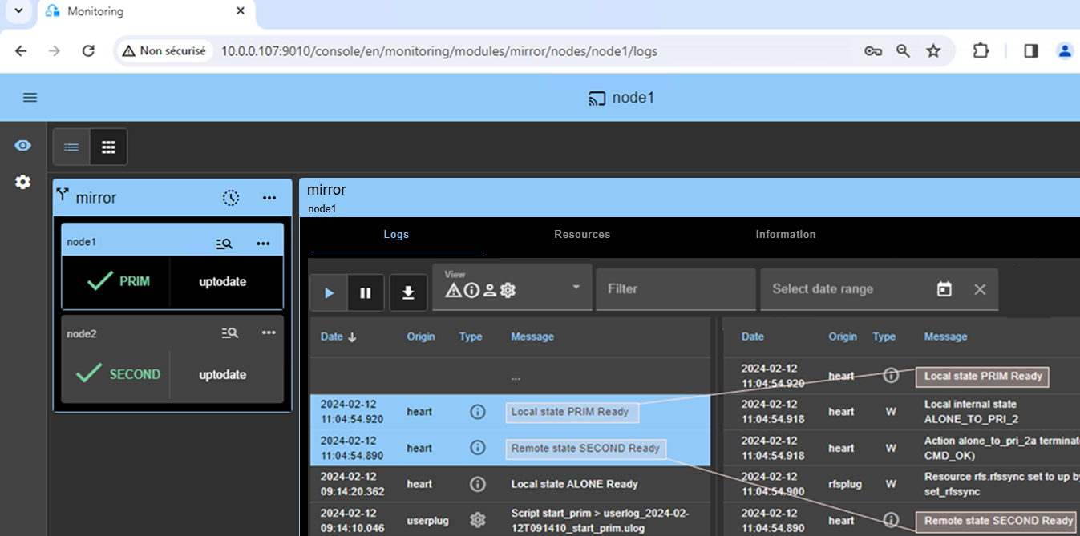
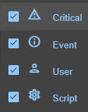
Analyze yourself the module log
Filter message content
View selected date range
Log analysis in or with command lines
Resume/suspend real time view
Download the log in a .txt file
Click to view the verbose log
Select the message type to view
C(ritical) messages (error detection…)
E(vent) messages (local and remote state…)
U(ser) messages when the user runs action on the module
(ex.: Action stop called by username)
S(cript) messages when module scripts are executed
SAFE, SAFEVAR | Windows | C:/safekit/, C:/safekit/var/ | SAFE/safekit logview –m AM –A SAFE/safekit logsave –m AM -A
 | Linux | /opt/safekit/, /var/safekit/
Notes:
You can make the log analysis either with the monitoring feature of the console or with command lines. In the console, first select the module and the node on the left side. Then the log of the module on the node is displayed on the right side. The log is displayed in real-time with three buttons: resume, suspend, and download.
By downloading the log to your workstation, you can use your favorite editor to analyze the messages. As shown in the second text box, the console provides an option to select messages according to their types. Here are the different message types you can select, represented by the four icons in the console:
The first icon represents critical messages associated with error detection.
The second icon represents event messages related to changes in local or remote states.
The third icon represents user messages when the user performs an action on the module.
The fourth icon represents script messages when module scripts are executed.
These four types of messages are saved in a log named the non verbose log.
As shown in the third text box, you can also filter messages based on content or a date range.
Finally, you will find in the root directory of SafeKit, two command lines to help with debugging: safekit logview and safekit logsave. The dash A option allows to have the verbose log.

Slide 5
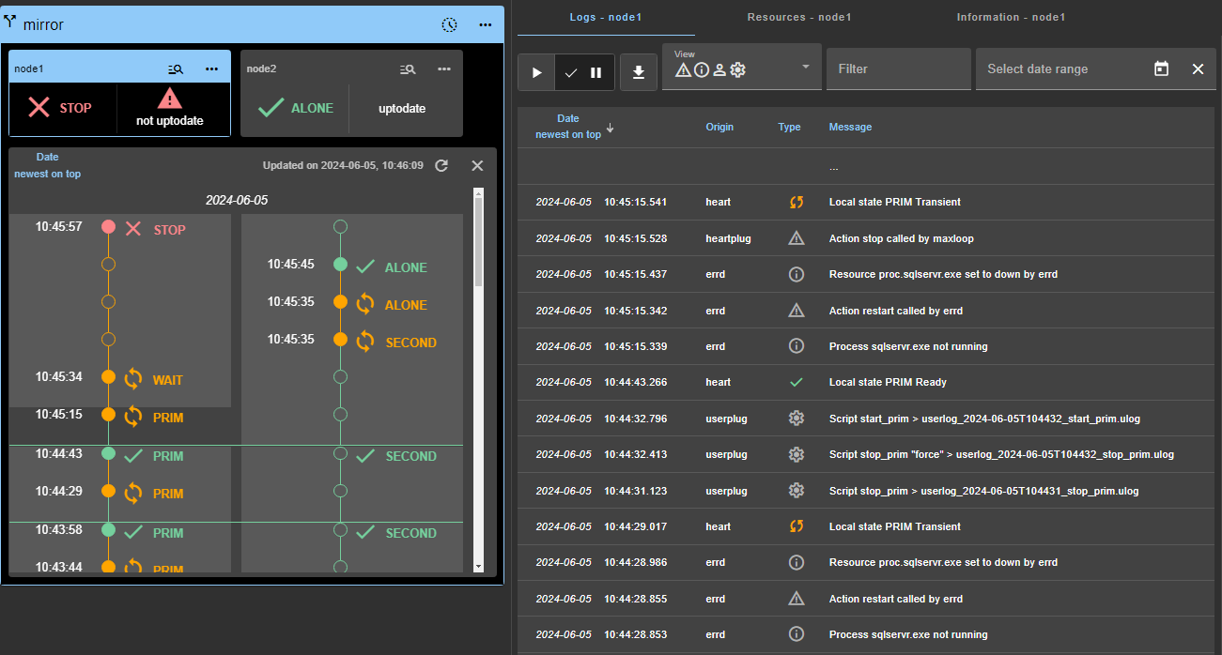
Analyze with the module states timeline
State on all nodes over time, starting by the newest date (since SafeKit 8.2.2)
Click to open/close the timeline
Click to display the module log for the node starting at this date
Notes:
Let's explore the module states timeline feature.
To access this feature, click on the clock icon located in the window's header. The timeline will appear as shown in the figure on the left. This timeline displays the module states on all nodes in reverse chronological order, starting with the most recent date. This visual representation helps administrators quickly understand the current status and historical changes of the module.
The timeline shown is the one available at the time of loading. To refresh the timeline with the latest state changes, simply click on the refresh icon. Additionally, you can click on an event in the timeline. As shown in the figure on the right, the module log associated with the event will be displayed.
It's important to note that the clocks of the two nodes must be synchronized for the state changes to be accurately mapped. This ensures that the timeline provides meaningful and precise information about the module states.

Slide 6
Module log messages (1/2)
For a full list of main messages, see “Log Messages Index” in the User’s Guide
 | Messages in the module log
errd | Process mysqld.exe not running Action restart called by errd
ip | Resource ip.172.24.199.100 set to down by ipcheck Action stopstart from failover rule ip_failure
custom | Resource custom.http set to down by checker_http Action restart from failover rule c_http
tcp | Resource tcp.Web_80 set to down by tcpcheck Action restart from failover rule t_Web_80* Note: Before SafeKit 8.3.2, the failover rule was static and named tcp_failure
For custom, TCP, and ping checkers, the rule name syntax is <checker initial>_<ident attribute value>
Notes:
Let's consider now some main module log messages. For a full list of messages, please refer to the "Log Messages Index" in the User’s Guide.
In the module log, you will encounter various types of messages emitted upon error detection by checkers, along with the actions triggered to solve the error. For instance, the process monitoring message issued by err d indicates that the process my sql d.exe was not running. Consequently, an action restart was initiated by err d to restart the application. Secondly, the `ip` message shows that the virtual IP checker has set its resource to down, meaning that either there was a duplicate virtual IP on the network or the virtual IP has been removed. The action stopstart has been triggered from the failover rule `ip_failure`, to reconfigure the virtual IP. Thirdly, the resource `custom.http` has been set to down by a custom checker, and an action restart has been initiated from the failover rule `c_ http` to restart the application. Fourthly, the `tcp` checker has set its resource to down because it has detected an impossibility to make a TCP connection to the application. The action restart has been triggered from the failover rule `t_ Web_80` to restart the application. Note that the failover rule names of TCP, ping, and custom checkers are prefixed by 't_', 'p_', and 'c_'.

Slide 7
Module log messages (2/2)
 | Messages in the module log
intf | Resource intf.172.24.199.0 set to down by intfcheck Action wait from failover rule interface_failure
ping | Resource ping.router set to down by pingcheck Action wait from failover rule p_router Note: Before SafeKit 8.3.2, the failover rule was static and named ping_failure
custom | Resource custom.sql set to down by checker_sql Action stopstart from failover rule c_sql
module | Resource module.sqlserver set to down by modulecheck Action wait from failover rule module_failure
splitbrain | Resource heartbeat.default set to down by heart Resource heartbeat.flow set to down by heart Resource splitbrain.witness set to down by pingcheck Resource splitbrain.uptodate set to down by splitbraincheck Action wait from failover rule splitbrain_failure
Notes:
Let's consider other main module log messages coming from checkers.
Firstly, the network interface checker message indicates that the interface was detected down. The action wait has been triggered from the failover rule interface_failure, waiting for the repair of the network interface.
Secondly, the ping message shows that the ping checker has set its resource to down because its ping to an external component is not answering. An action wait has been triggered from the failover rule p_router, waiting for the external component to answer again to ping.
Thirdly, the resource custom.sql has been set to down by a custom checker, and an action stopstart has been initiated from the failover rule c_sql, to restart the application on the other node if it was running the module.
Fourthly, the module checker message means that the external SQL Server module was down and the action wait was initiated from the failover rule module_failure, waiting for the restart of the external SQL Server module.
Fifthly, the splitbrain message shows that all heartbeats have been lost and the splitbrain checker was not able to reach the witnesses. Thus, the action wait has been triggered from the failover rule splitbrain_failure, to wait for the recovery of heartbeats.

Slide 8
Best practices to analyze the module log
Identify the root cause of a problem
When there is a loop of errors
When the problem is global
Read first the non verbose log
  See “Log Messages Index” of the SafeKit User’s guide”
Go to the date when the problem occurred
Go up in the log to identify the cause
Go up in the log to find a stable state
  “Local state ALONE Ready”, “Local state PRIM Ready”, “Local state SECOND Ready”, “Local state UP Ready”
Then, go down in the log to the initial error
Open the log of node1 and node2 in 2 different windows facing each other
Match node1 and node2 messages by date
  Note that the clocks on nodes may be desynchronized
Notes:
Let's consider now the best practices to analyze the module logs.
Start by identifying the root cause of a problem. For that, firstly, read the non verbose log. Secondly, go to the date when the problem occurred. Thirdly, go up in the log to identify the cause of the problem.
When there is a loop of errors, firstly, go up in the log to find a stable state, like "Local state ALONE Ready", "Local state PRIM Ready" or "Local state SECOND Ready" for a mirror module, or "Local state UP Ready" for a farm module. Secondly, go down in the log to find the initial error.
When the problem is global, firstly download and open the log of node1 and node2 in two different windows, facing each other. Secondly, match node1 and node2 messages by date, to understand how the cluster has globally evolved. Be careful if the clocks on nodes were not synchronized.

Slide 9
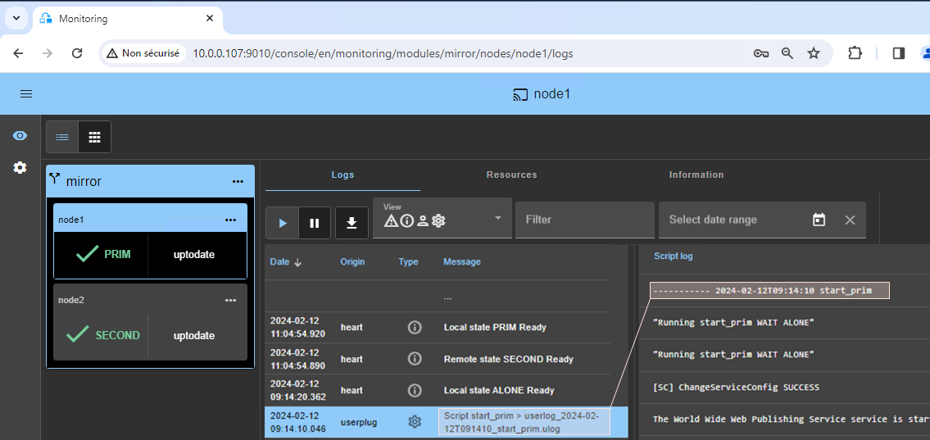
Analyze yourself the script log
Log analysis in or with command lines
Click view the output
of the script execution
SAFEVAR/modules/AM/userlog_AAAA_MM_DDThhmmss_<script-name>.ulog
Notes:
After examining the module log, let's now look at the script log, which contains the output messages of the restart scripts. You can analyze the script log either with the console or on the node side.
As shown in the figure, you can click on a restart script message, such as start_prim, to open the script log for this script on the right side. You will find the outputs of service startups and stops in the script logs, along with any potential error messages that can help with debugging.
On the node side, the script logs are located in the var directory of SafeKit under the directory of the module. Each restart script execution is logged in an individual line with its date and time of execution.

Slide 10




Best practices to analyze the script log
Problem analysis
Script
Messages in logs
Read messages from scripts in the script
log
Search for messages from scripts in the module log
Understand application errors
  in the event log on Windows
  in the system log messages on Linux
  in specific application logs (not included into the snapshot)
start_prim.cmd
  @echo off
  echo "Running start_prim %*"
  net start "myservice" /Y
  if NOT %errorlevel% == 0 goto stop
  :stop
  "%SAFE%\safekit" printe "start_prim failed"
  "%SAFE%\safekit" stop -i "start_prim"
Script log
----------- 10/20 18:28:11 start_prim
"Running start_prim WAIT ALONE"
The myservice service failed to start
Module log
10-20 18:28:11 … Script start_prim
10-20 18:28:12 … start_prim failed
10-20 18:28:12 … Action stop called by start_prim
Notes:
Let's talk about the best practices to analyze the script log.
Let’s explain the problem analysis in the slide. Among the messages in the script log, like the messages of point 1 and point 2 on the right of the slide, you should search for error messages, typically the message 2 which indicate that the service failed to start. Scripts can log messages or execute commands in the module log, as shown in points 3 and 4 on the right side of the slide. Look for error messages logged by the script, such as message 3 indicating that the start prim script has failed. Also, search for actions initiated by the script, like message 4, which indicates that a stop action was initiated by the start prim script.
Finally, it is necessary to understand application errors when the application has not been started or stopped correctly. On Windows, you can find these errors in the event log. On Linux, check the system log messages. Additionally, specific application logs, which are not included in the SafeKit snapshot, can also provide valuable information.

Slide 11
Running the application without SafeKit
Notes:
Let's now explain how to run an application integrated inside SafeKit but without the SafeKit runtime.

Slide 12
Running an application without SafeKit
The need for this use case
Procedure for a module named AM
You want no SafeKit processes running, only your application
You want to start/stop your application with the start_prim/stop_prim or start_both/stop_both scripts
You want to set the virtual IP address as an alias on the local network interface, if <vip> is defined in userconfig.xml
You want to pass environment variables defined in <user> of userconfig.xml
Stop AM on all nodes
Log in as an administrator/root
Open a PowerShell/shell console
To start the application, run the command SAFE/private/modules/AM/bin/AM_start_wrapper. {ps1,sh}
To stop the application, run the command
  SAFE/private/modules/AM/bin/AM_stop_wrapper. {ps1,sh}
Note: wrappers are generated at each configuration of the module
Notes:
Let's first discuss the need for this use case. You want no SafeKit processes running, only your application. You want to start or stop your application using the start prim and stop prim scripts in a mirror module or the start both or stop both scripts in a farm module. You want to set the virtual IP address as an alias on the local network interface, if a vip tag is defined in userconfig.xml. Lastly, you want to pass environment variables defined in the user tag of userconfig.xml to the start and stop scripts.
Now let's examine the procedure for a module named AM.
Firstly, stop AM on all nodes.
Secondly, log in as an administrator on Windows or root on Linux.
Thirdly, open a PowerShell on Windows or a shell console on Linux.
To start the application, go to the private/modules directory and run the start wrapper script of the module.
To stop the application, run the stop wrapper script of the module.
Please note that wrappers are generated at each configuration of the module.

Slide 13
Take module snapshots for support
Notes:
Let’s see how to take module snapshots for supporting a customer.

Slide 14
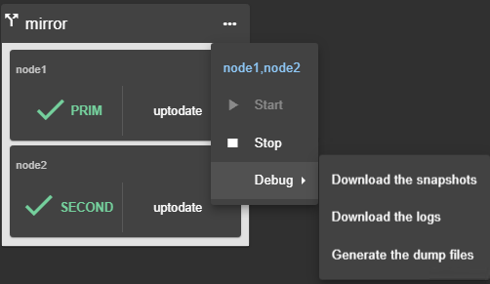


How to take a module snapshot?
Take a snapshot of the module on each node for offline and in-depth analysis
With the web console
With the safekit command
In
Open the module menu
Select Debug/Download the snapshots
On each node
Log in as administrator/root
Open a PowerShell/shell console
Change directory to the SafeKit installation root path
Run with an absolute path
safekit snapshot –m mirror /abs_path/snapshot_node1_mirror.zip
Repeat the operation on the other node
Take a dump in real-time when a replication problem arises
safekit dump –m AM (dumps are collected in snapshots)
Execute on both nodes when the problem arises to save real-time replication logs
Saved in SAFEVAR/snapshots/modules/AM/dump_yyyy_mm_dd_hh_mm_ss
Notes:
For supporting a customer, you have to take a module snapshot on each node, either with the web console or with the safekit command. As shown in the figure on point 1, you can download both mirror module snapshots from node 1 and node 2 by clicking on the global menu of the mirror module and opening the debug submenu. This will download on your workstation two .zip files corresponding to the two module snapshots of the two nodes.
To do the same with the safekit command, you will have to execute the following procedure twice on node 1 and on node 2:
Firstly, log in as an administrator on Windows or root on Linux.
Secondly, open a PowerShell on Windows or a shell on Linux.
Thirdly, go to the root directory of SafeKit.
Fourthly, run the safekit snapshot command, providing the module name and the absolute path of the .zip file. This file will be created and will contain the module snapshot of the node.
Fifthly, repeat the same procedure on the other node.
There is also a dump command useful to dump in real-time all SafeKit logs, which is helpful to capture a state in real-time when typically a replication problem occurs. The dump will be included in the snapshot operation.

Slide 15
What is a module snapshot?
What is a module snapshot?
Internals of a module snapshot
A snapshot is a zip file associated to a node that contains:
the last 3 configurations
the last 3 dumps of the module
Locations in the snapshots.zip | Location in the snapshots.zip
configs | <module-name>/config_<date>/
dumps | <module-name>/dump_<date>/
Notes:
Let's now examine what a snapshot is and where you can find interesting information to analyze a problem. A snapshot is a zip file that contains the last three configurations of a module and the last three dumps of a module on a node. Inside the zip file, you will find directories associated with these configurations and these dumps.

Slide 16
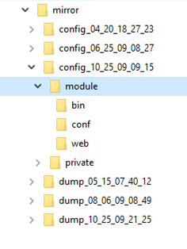
Configuration files of a module in a snapshot
Problem analysis
Configuration files
Inside the snapshot
Select the last configuration
Verify userconfig.xml and scripts for troubleshooting with the application integration
If necessary, compare the different configurations
bin/start_prim bin/stop_prim or bin/start_both bin/stop_both | User scripts for mirror or farm modules
conf/userconfig.xml | XML configuration file of the module
Notes:
Let's examine the module configuration in a snapshot. As illustrated in the right figure, begin by opening the directory containing the latest configuration,. Within this directory, you'll find the CONF subdirectory, which houses the userconfig.xml file of the module. Additionally, you’ll find the bin subdirectory, which contains the start prim and stop prim scripts for a mirror module, or the start both and stop both scripts for a farm module. By examining these files, you can gain insights into how the application has been configured within the module and troubleshoot the application integration. If needed, you can compare these files with previous configurations to identify any changes or discrepancies.

Slide 17
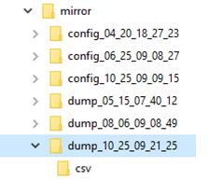

Text files in a dump including logs and more
Problem analysis
Text files
Inside the snapshot
Select the dump with the date closest to the problem.
Open the module log.txt (checker actions, module state transitions).
Check the scripts logs for application start/stop issues (userlog subdirectory)
Search for errors in the Windows or Linux event logs
Check cluster.xml for network communication issues between nodes
Check heartplug.txt for a detailed network configuration of the node
Check heartplug.txt for the OS and SafeKit versions, license, list of installed modules…
log.txt,, logverbose.txt | Module logs (non verbose and verbose)
userlog/*.ulog files | Scripts logs (output of module scripts)
applicationevtx.txt & systemevtx.txt | Windows event logs
last.txt & systemevt.txt | Linux event logs
var/cluser/cluster.xml | XML configuration file of the cluster
heartplug.txt | Node information (OS, SafeKit version, license, modules list, network, ...)
commandlog.txt | Command log of the node
log.txt
logvervose.txt
applicationevtx.txt systemevtx.txt
cluster.xml
heartplug.txt
commandlog.txt
userlog
Notes:
Let’s now consider how to analyze a problem in a module dump. As shown in the figure on the right, first open the dump with the date closest to the problem. In this dump, open the module log.txt file to review checker actions and module state transitions. Then, check the script logs in the userlog subdirectory for application start or stop issues. Also, use the Windows or Linux event logs to understand issues on application errors. If you have any network communication issues between nodes, examine the cluster.xml file to see how the networks are configured. Check also the detailed network configuration of the node in the heartplug.txt file, which contains network interfaces with their physical IP address, netmask, and virtual IP address if configured on the node. You will also find in the heartplug.txt file the OS and SafeKit versions, the license, the list of installed modules, the list of services installed on the node, and much more. Finally, the commandlog.txt file provides the list of SafeKit commands passed on the node.

Slide 18

Csv files in a dump for analysis with Excel
Analysis with Excel
csv files
Smart extraction
Import the csv files into an Excel sheet
Create a new sheet
From the Data tab, import From Text/CSV
In the dialog box, locate and double-click the csv file to import and click Import, then Load
For a more precise date, format cells with Number/Custom: jj/mm/aaaa hh:mm:ss,000
Use the Excel features to filter rows
logverbose.csv | Verbose module log
resource.csv resourcelog.csv | Module resources status and history
clusterstate.csv | SafeKit cluster state
commandlog.csv | Commands log on the node
logverbose.csv
resource.csv
resourcelog.csv
clusterstate.csv
commandlog.csv
Notes:
To facilitate searching and sorting through messages, the dump also provides CSV files that can be imported into Excel. For instance, with the logverbose.csv file, once it's in an Excel table, you can easily apply filters to view only specific types of messages. This makes it much simpler to focus on the information you need.
This is a way to present a detailed report to the client about an issue that occurred in the cluster, leveraging the full power of Excel. Additionally, you can combine the logverbose.csv files from both nodes into a single Excel file and sort by date. This allows you to see how the cluster has evolved overall, providing a comprehensive view of the global cluster's behavior over time.
The procedure on the left explains how to import a CSV file into an Excel file. Just be careful with the date formatting to ensure millisecond precision. The primary file to consider for importing into Excel is the verbose log of the module. However, you also have the files for module resources status and their history, as well as the SafeKit cluster state and the commands log of the node.

Slide 19

Other files in a dump to check license or web configuration
Problem analysis
Additional files
Inside the snapshot
Check the license file for SafeKit license issues
Check the Apache configuration for web service issues
licenses/ | Verify license file and hostnames inside
var/ | Extract of SAFEVAR directory
web/ | Apache configuration
Notes:
As shown in the figure on the right, there are three additional subdirectories in the module dump. The licenses subdirectory contains the SafeKit license key files This can be useful for resolving issues related to the license key, such as the hostnames set inside the license key file are not the hostname of the nodes. The var subdirectory is a copy of the var directory of the node, including various runtime data. Lastly, the web directory contains the Apache configuration for the SafeKit web service, detailing how the web service is set up and managed. This can be useful for resolving issues with the SafeKit web service.

Slide 20
Web console issues
Notes:
Let's now examine the issues that may arise with the web console.

Slide 21
Web console load or connection errors
Check the browser
Check the SafeKit nodes
Proxy and security settings
Same release number for the web console and the SafeKit nodes
Clear the browser’s cache with CTRL and SHIFT while tapping the DELETE key
Firewall and SafeKit web service setup
SafeKit cluster configuration
safeadmin and safewebserver services are running
For HTTPS, see "Connection issues with the HTTPS web console" in the SafeKit User’s Guide
Notes:
You may encounter web console load or connection errors. First, check the browser. Verify the proxy and security settings in the browser. Ensure that the web console and the SafeKit nodes are running the same release number. Clear the browser’s cache by pressing CTRL and SHIFT while tapping the DELETE key. Secondly, check the SafeKit nodes. Check the firewall and SafeKit web service setup. Verify the SafeKit cluster configuration. Ensure that the safeadmin and safewebserver services are running. For HTTPS, refer to the "Connection issues with the HTTPS web console" section in the SafeKit User’s Guide.

Slide 22
Authentication troubleshooting with the web console
Authentication failure of admin user or connection errors on the other node
Same password on all nodes is mandatory
To reset the password, on each node :
Log in as administrator/root
Open a console (PowerShell, shell, ...)
Run
Windows | C:/safekit/private/bin/webservercfg.ps1 -passwd pwd
Linux | /opt/safekit/private/bin/webservercfg -passwd pwd
 | where pwd is your password
Notes:
To troubleshoot authentication issues with the web console, ensure that the same password for the admin user is used on all nodes. To reset the password on each node, log in as administrator on Windows or as root on Linux, open a console such as PowerShell or shell, and run the webserverCFG command with your password. By setting the same password on both nodes, this should resolve any authentication failures of the admin user or connection errors on the other node.

Slide 23
Command line issues
Notes:
Let's now examine the issues that may arise with the command lines.

Slide 24
Unsuccessful global command safekit -H "..."
Authentication issue for the global command (or the web console)
Test the global command
Reset password on all nodes
Log-in as administrator/root
Open a console (PowerShell, shell, …)
Example with an issue on node1 safekit -H "*" level
  ---------------- Server=http://10.0.0.107:9010 ----------------
  curl: (22) The requested URL returned error: 401 Unauthorized
  ---------------- Server=http://10.0.0.108:9010 ----------------
  admin action=exec
  ----------------------------- Versions -----------------------------
  Serveur : node2
  SE : Microsoft Windows Server Standard [64-bit] (10.0.17763 ) Server
  SafeKit : 7.5.1.50
  Licence : PAS de licence : Démo 3 jours
  Success
Same password is mandatory on all cluster nodes
To reset it, on each node:
Log as administrator/root
Open a console (PowerShell, shell, …)
Run with pwd = your password
    SAFE/private/bin/webservercfg -passwd pwd
    reset password for the global command and the admin user of the web console
    or
    SAFE/private/bin/webservercfg -rcdmpasswd pwd
    reset password only for the global command
Notes:
If you encounter an unsuccessful global command with safekit dash H, it may be due to an authentication issue.
In this case, test the global command by logging in as administrator on Windows or root on Linux and opening a console such as a PowerShell or a shell. Test the global command with 'safekit dash H star level'. If there is a curl error with the unauthorized message, it means that there is an authentication issue between nodes.
This problem may be due to the fact that the password is not the same on all the nodes. To reset it, on each node, log in as administrator on Windows or root on Linux, open a console such as a PowerShell or a shell, and run the webserverCFG command to reset the admin password on both nodes. Alternatively, you can run webserverCFG to reset the password only of the global command.

Slide 25
Mirror module issues
Notes:
Let's now examine the issues that may arise with a mirror module.

Slide 26


No nodes are uptodate
When?
Problem solving
PRIM - SECOND
At first installation
After a double simultaneous power outage
Resource rfs.uptodate is down on both nodes (safekit state -v –m AM)
Select the node that you consider as up-to-date and start it as primary
safekit prim –m AM
Start the other node with full synchronization of data
safekit second fullsync –m AM
node1 (not uptodate)
node2 (not uptodate)
node1 (uptodate)
node2 (not uptodate)
node1 (uptodate)
node2 (uptodate)
NotReady
NotReady
Ready
NotReady
Ready
Ready
STOP
STOP
ALONE
STOP
PRIM
SECOND
Notes:
An issue arises in a mirror module when no nodes are up to date. In this case, as shown at the bottom of the slide, the console shows two nodes in the STOP red state with the "not uptodate" message. If you try to start both nodes with the start command, they will both go into the WAIT red state, because they will detect that they are not up to date and cannot start without resynchronizing their local data.
This situation arises at the first installation or after a double simultaneous power outage. In this case, the resource rfs.uptodate is down on both nodes, and you can check this value using the safekit state dash v command.
To solve this problem, select the node that you consider to be up-to-date, let's say node 1 in our example, and start it as the primary node using the safekit prim command. Node 1 will then transition to the ALONE green state. Next, start the other node, node 2 in our example. Use the safekit second fullsync command if you want a full synchronization of its data. After the synchronization, the cluster will return to the PRIM-SECOND green state.

Slide 27
Application not operational
Application not operational
Problem solving
Application
Not started
Not operational
Inaccessible by clients
Verify scripts start_prim/stop_prim
Search for errors in the script log
SAFEVAR/modules/AM/ userlog_AAAA_MM_DDThhmmss_start_prim.ulog
Search for errors in the application and event system logs
Search for errors in the error logs specific to the application
Try a local restart of the application with safekit restart –m AM
If PRIM, try a failover to start the application on the other node with safekit stop –m AM
Verify that the application's clients are configured to connect to the virtual IP
Reboot the node
node1 (uptodate)
node1 (uptodate)
Ready
or
Ready
PRIM
ALONE
Notes:
Let's consider a node that is in the PRIM green state or ALONE green state, which typically means the application is running. However, the application is not started, not operational, or inaccessible by clients.
To address this issue, first verify the start prim and stop prim scripts and search for errors in the script log of the module located in the SafeKit var directory. Then, check for errors in the application and event system logs of Windows or Linux. Additionally, search for errors in the error logs specific to the application.
You can try a local restart of the application using the safekit restart command. If the node is in the PRIM state, attempt a failover to start the application on the other node using the safekit stop command on the PRIM node. Ensure that the application's clients are configured to connect to the virtual IP. If all else fails, reboot the node.

Slide 28


File synchronization failures
<service maxloop="3" loop_interval="24" > in userconfig.xml
3 successive synchronization failures on node 2
Problem solving
node1 (uptodate)
node2 (not uptodate)
Search for errors in the module log on both nodes
safekit logview –A –m AM
File access error on the secondary
Check that the application is correctly stopped on the secondary and that its start at boot is manual
Exclude replicated directories from antivirus scanning
Timeout on request processing
Check that the network and the disk are working properly
Start the secondary during an off-peak period
Ready
NotReady
ALONE
STOP
Transient
Transient
stopstart after failure
ALONE
SECOND
Ready
NotReady
stop after 3 failures
ALONE
STOP
On synchronization failure, data are inconsistent on node2
Notes:
Let's now consider a file resynchronization issue with node 2. Node 2 attempts resynchronization of its files three times (the maxloop value) before stopping. Each time, the resynchronization fails, and ultimately, the data are not resynchronized on node 2. As a result, the files remain inconsistent on node 2 due to partial resynchronization.
When faced with this problem, the first step is to search for errors in the module log on both nodes. Start with the module log of the secondary node. Use the safekit logview command with the dash A option, to get the verbose log, and retrieve all messages from the resynchronization process.
If you encounter a file access error in the module log of the secondary node, ensure that no remaining process of the application locks the files, preventing the resynchronization process from succeeding. Additionally, verify that the stop prim script stops all services of the application and that these services are set to start manually at boot.
Also, exclude replicated directories from antivirus scanning to prevent interference between the antivirus checking files and the resynchronization process.
In the case of a timeout on request processing, verify that both the network and the disk are functioning properly. It's also advisable to start the secondary during an off-peak period to avoid any potential issues.

Slide 29

ALONE degraded
Before
ALONE degraded
Problem solving
PRIM-SECOND
Functional replication
Non-functional replication
Application still running on ALONE
Resource rfs.degraded is up
safekit state -v –m AM
Return to normal mode by forcing a stop-start of the primary
safekit stop –m AM
safekit prim –m AM
node1 (degraded)
node2 (not uptodate)
Ready
NotReady
ALONE
WAIT
Notes:
Let's now consider the issue with the ALONE degraded state on node 1. Before the degradation, the state was PRIM-SECOND, indicating a functional replication.
Then, due to an issue in the replication mechanisms of node 1, the PRIM node transitions to the ALONE green degraded state, while the other node transitions to the WAIT red state, waiting to resynchronize data from the ALONE node. The application is still running on the ALONE degraded node, but the replication mechanisms are non-functional, and it is not possible to resynchronize data from the ALONE degraded node.
You can check the degraded status with the resource named rfs.degraded and displayed with the `safekit state` command with the `dash v` option.
To solve this problem and restore the replication mechanisms on the ALONE degraded node, stop node 1 with the safekit stop command and then start it as primary with the safekit prim command. Then, node 2 in the WAIT red state will be able to resynchronize its data.

Slide 30
Communication failure between both nodes
Communication failure
Problem solving
States of the cluster is not coherent
safekit state –v –m AM
Verify on each node:
safeadmin service
Same signature for the SafeKit cluster
    safekit cluster confinfo
Same signature and id for the module
    safekit –H "*" cluster state
Firewall setup
Network connection and DNS resolver
node1 (uptodate)
node2 (not uptodate)
Ready
NotReady
ALONE
WAIT
Notes:
Let’s now consider a strange and incoherent state of the cluster, where node 1 is in the ALONE green state, ready to accept a resynchronization from node 2. However, node 2 is in the WAIT red state, waiting for node 1 to accept its resynchronization. In this case, there is a communication issue between node 1 and node 2. Note that the states of each node can be displayed using the `safekit state` command.
To solve this issue, verify the following on each node:
Confirm that the `safeadmin` service is running properly.
Ensure that the SafeKit cluster has the same signature on both nodes by using the `safekit cluster confinfo` command.
Confirm that the module has the same signature and ID by using the `safekit cluster state` command with the `dash H star` option.
Check the firewall setup to ensure there are no blocking rules.
Finally, verify the network connection and DNS resolver to ensure they are functioning correctly.

Slide 31
Farm module issues
Notes:
Let's now examine the issues that may arise with a farm module.

Slide 32
Virtual IP issues
Virtual IP issues
Problem solving
A mosaic test is delivered with SafeKit.
Set the following load balancing rule in userconfig.xml:
    <rule port="9010" proto="tcp" filter="on_port"/>
On an external workstation, connect a browser to the URL: http://virtip:9010/safekit/mosaic.html
Check that you are on an external workstation and not on the nodes themselves
Check that the network, on which the virtual IP is configured on both nodes, is in the same subnet for both servers (prerequisite).
  On Windows: ipconfig /all
  On Linux: ip addr show
On each node, check the connections on the virtual IP
  On Windows: netstat –an | findstr <virtual IP>
  On Linux: netstat –an | grep <virtual IP>
Stop/start the module on each node to check which one is taking connections
Load balancing OK
Load balancing KO
node1
node2
node1
node2
node2
node1
node1
node1
node1
node1
node1
node1
Notes:
The first thing you want to know with a farm module is whether the load balancing on the virtual IP address is functioning correctly. SafeKit provides a way to verify this with a mosaic through its web service.
First, set a load balancing rule on TCP port 9010, which is the port of the SafeKit web service, and configure the filter with the "on_port" value. This configuration allows the TCP sessions of the same client to be load balanced across all nodes of the farm.
Secondly, from an external workstation (be careful, not a local node of the cluster), connect a browser to the virtual IP using HTTP, port 9010, and the mosaic.html URL. In the form that follows, enter the name of the module to be tested.
If the farm module is running on both nodes, meaning node 1 is in the UP green state displaying 50% and node 2 is also in the UP green state displaying 50%, you will see a colored mosaic. Each square in the mosaic represents a TCP connection response from either node 1 or node 2. However, if the load balancing is not working, you will only see responses from one node.
To solve an issue with virtual IP load balancing, follow these steps:
Firstly, ensure that you are on an external workstation and not on the nodes themselves. On a node, a browser will display only local TCP connections to that node.
Secondly, verify that the network interface, on which the virtual IP is configured as an alias IP on both nodes, is in the same subnet for both nodes. This is a prerequisite for proper load balancing. To check the network configuration, use IP CONFIG /all on Windows and ip ADDR show on Linux.
Thirdly, on each node, check if the node is managing connections on the virtual IP. To do this, use the netstat command with a filter on the virtual IP and check if there are any established connections or connections in the TIME WAIT state. This will help you determine if the node is actively handling network traffic on the virtual IP.
Fourthly, stop and start the module on each node to determine which one is taking connections and which one is not.

Slide 33
Communication failure between the nodes
Communication failure
Problem solving
Nodes do not see each other's state (safekit logview –A –m AM)
The load is not balanced (100% / 100%)
Internal protocol failure
Verify on each node:
safeadmin service
Same signature for the SafeKit cluster
    safekit cluster confinfo
Same signature and id for the module
    safekit –H "*" cluster state
Firewall setup
Network connection and DNS resolver
node1
node2
Ready
Ready
UP
UP
100%
100%
Notes:
Let’s now consider a strange and incoherent state of the cluster, where node 1 is in the UP green state managing 100% of the traffic and node 2 is in the UP green state managing also 100% of the traffic. In this case, there is a communication issue between node 1 and node 2.
To solve this issue, verify the following on each node:
Confirm that the `safeadmin` service is running properly.
Ensure that the SafeKit cluster has the same signature on both nodes by using the `safekit cluster confinfo` command.
Confirm that the module has the same signature and ID by using the `safekit cluster state` command with the `dash H star` option.
Check the firewall setup to ensure there are no blocking rules.
Finally, verify the network connection and DNS resolver to ensure they are functioning correctly.

Slide 34
Application not operational
Application not operational
Problem solving
Application
Not started
Not operational
Inaccessible by clients
Verify scripts start_both/stop_both
Search for errors in the script log
SAFEVAR/modules/AM/ userlog_AAAA_MM_DDThhmmss_start_prim.ulog
Search for errors in the application and event system logs
Search for errors in the error logs specific to the application
Try a local restart of the application with safekit restart –m AM
Verify that the application's clients are configured to connect to the virtual IP
node1
Ready
UP
Notes:
Let's consider a node that is in the UP green state, which typically means the application is running. However, the application is not started, not operational, or inaccessible by clients.
To address this issue, first verify the start both and stop both scripts and search for errors in the script log of the module located in the SafeKit var directory. Then, check for errors in the application and event system logs of Windows or Linux. Additionally, search for errors in the error logs specific to the application.
You can try a local restart of the application using the safekit restart command.
Ensure that the application's clients are configured to connect to the virtual IP.

Slide 35
Checker issues
Notes:
Let's now examine the issues that may arise with checkers.

Slide 36

Deactivate errd
Application maintenance or errd bad behaviour
Deactivation without reconfiguration
Deactivation with reconfiguration
Deactivate with
the console
Select the node/”Disable/Enable”/”Processes/services monitoring”/Disable
(Enable to reactivate)
the command
    safekit errd off –m AM
    (on to reactivate)
Resource: usersetting.errd="off"
  Edit the module configuration with
    the console http://host:9010/console/en/configuration/modules/AM/config
    text editor
    SAFE/var/module/AM/conf/userconfig.xml
  Set action="noaction“ in errd section or comment the section and save
    <!– Start of comment <errd> … </errd> End of comment -->
  Stop the module to apply the new configuration
Notes:
For maintenance operations that require stopping the application monitored by SafeKit, it may be necessary to disable process monitoring to avoid an automatic restart triggered by err d. This might also be the case if err d triggers automatic restarts that are not desired by the user.
Firstly, let’s examine how to deactivate err d without reconfiguring the module. To suspend or resume process and service monitoring, you can either use the console or the commands: safekit err d "off" and safekit err d "on". To check if err d monitoring is on or off, you can consult the status of the resource named usersetting.err d.
Secondly, let’s examine how to deactivate err d with reconfiguration of the module. For this, you can edit userconfig.xml either with the console or directly on the node. You can set action="noaction" in the err d section of userconfig.xml to deactivate the monitoring of a process or a service. This way, you will only receive a message in the module log, but no action will be triggered. Alternatively, you can comment out the err d section. Note that there should be no comments included within these comments.
Then, you need to stop the module, distribute the userconfig.xml on all nodes, reconfigure the module on all nodes, and then restart the module.
All these operations are simpler to perform using the console.

Slide 37
Deactivate checkers
Application maintenance or checkers bad behaviour
Deactivation without reconfiguration
Deactivation with reconfiguration
When the module is started, deactivate with
the console
Select the node/”Disable/Enable”/”Checkers”/Disable
(Enable to reactivate)
the command
    safekit checker off –m AM
    (on to reactivate)
Resource : usersetting.checker="off"
  Edit the module configuration with
    the console http://host:9010/console/en/configuration/modules/AM/config
    text editor
    SAFE/var/module/AM/conf/userconfig.xml
  Comment checker and failover sections and save
    <!– Start of comment <checker> … </checker> End of comment -->
    <!– Start of comment <failover> … </failover > End of comment -->
  Stop the module to apply the new configuration
Notes:
In the same way, for maintenance operations that require stopping the application monitored by SafeKit, it may be necessary to disable checkers to avoid an automatic restart triggered by them. This might also be the case if the checkers trigger automatic restarts that are not desired by the user.
Firstly, let’s examine how to deactivate checkers without reconfiguring the module. To suspend or resume checkers, you can either use the console or the commands: safekit checker "off" and safekit checker "on". To check if the checker monitoring is on or off, you can consult the status of the resource named usersetting.checker.
Secondly, let’s examine how to deactivate checkers with reconfiguration of the module. For this, you can edit userconfig.xml either with the console or directly on the node. You can comment out the checker section and the failover section if it exists. Note that there should be no comments included within these comments. Then, you need to stop the module, distribute the userconfig.xml on all nodes, reconfigure the module on all nodes, and then restart the module.
All these operations are simpler to perform using the console.

Slide 38
Maxloop: stop after 3 error detections in 24 hours
<service maxloop="3" loop_interval="24"> in userconfig.xml
3 error detections in 24 hours
Problem solving
Protection mechanism against false error detection
Identify the checker causing the actions
Check that the checker is working properly
Verify that the functionality under test is operational when the checker is active
Delay the activation of the checker (start_after for errd ; sleep at start of a custom checker)
Increase the error detection timeout
Remove or comment out the checker configuration from the userconfig.xml
Transient
Ready
action restart or stopstart
requested by a checker
stop after 3 actions in 24h.
NotReady
Following messages in the module log
Action stop called by maxloop
STOP
Notes:
A common behavior of SafeKit that is often misunderstood is a restart or stopstart loop of a module on a node followed by a stop. This loop corresponds to an error detection on a node, an attempt to trigger a restart or stopstart action that does not resolve the error, reproducing the same error detection and a new restart or stop-start attempt, and so on. The loop is bounded by the maxloop variable in userconfig.xml, which causes the module to stop on the node. In this case, you will see the message “Action stop called by maxloop” in the module log.
To solve this issue, verify the following:
First, identify the checker causing the actions in the module log. Next, check that the checker is working properly, especially if it is a custom checker. Verify that the functionality under test is operational when the checker is active. If needed, delay the activation of the checker by using the start_after parameter for err d or adding a sleep command at the start of a custom checker. It could indeed be a case of the checker starting too quickly while the application is not yet fully launched. Additionally, increase the error detection timeout to allow more time for the application to respond to the repetitive tests of the checker. Finally, if necessary, remove or comment out the checker configuration from the userconfig.xml file.

Slide 39
Thank you !
Notes:
Thank you for your attention. If you have any questions or need further clarification, please feel free to ask.

